Slide 1
Developing an Environment for Reconfigurable Mesh Algorithms using Multi-Core Computers
Authors:
Daniel Laevski ID: 307575472
Nadav Inbar ID: 039063466
Supervisor:
Esti Stein, M.Sc

Slide 2
Outline
Introduction
Goal
Reconfigurable Mesh Model
How it works
Examples
Complexity
Related Work
Our Solution
Compiler Design
Compilation Process
Obstacles
Benefits and Future Plans
References

Slide 3
Introduction
The Reconfigurable Mesh (RM) serves as a theoretical model for massively parallel computing
RM has recently been investigated as a practical architecture for many-cores with light-weight, circuit-switched interconnects
As of today, there is a lack of learning environments for the RM, which include:
languages, programming environments, compilers, and debuggers

Slide 4
Goal
To provide a graphical environment for writing and running algorithms for RM
The environment will support: compiling (translating) the program, and run it with a graphical interface for a better debugging and understanding the RM flow
The environment will simulated the parallelism by running the algorithms in multi-threaded code

Slide 5
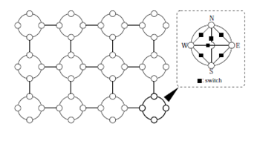
Reconfigurable Mesh Model
RM of size n x m consists of nm identical SIMD processors positioned on a rectangular array with n rows and m columns
All processing elements execute cycles of:
Bus configuration
Communication
Constant-time computation in a lock-step

Slide 6
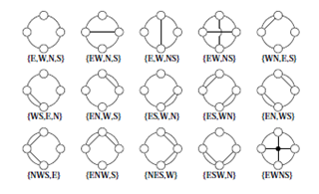
Reconfigurable Mesh – How does it work?
Mesh Architecture
Processing element (PE)
Connection autonomy, 15 possible patterns
Constant PE Computation time
Communication delay O(1)

Slide 7
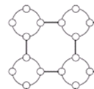
Reconfigurable Mesh – How does it work?
All processors work synchronously. A single step of an RM consists of the following 4 phases:
Read phase – receive data from a port
Calculation phase - execute constant-time local computations
Switch configuration phase - change the configuration of inner buses
Write phase - send data to a port

Slide 8
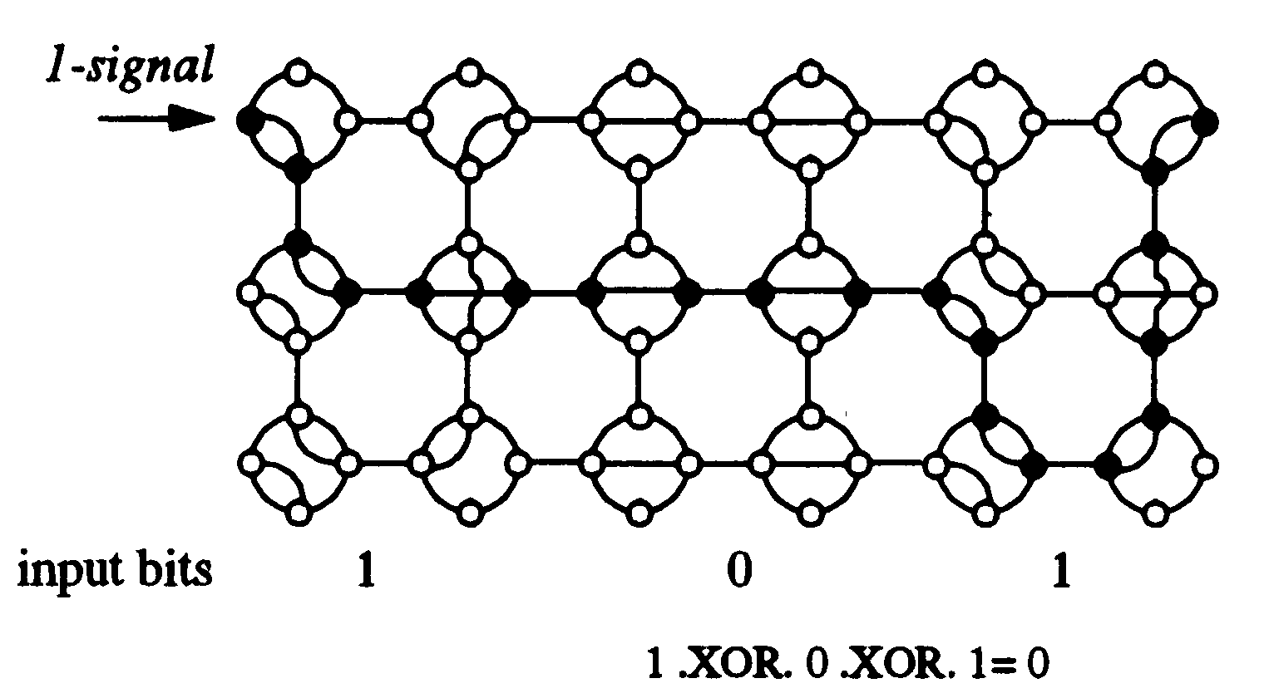
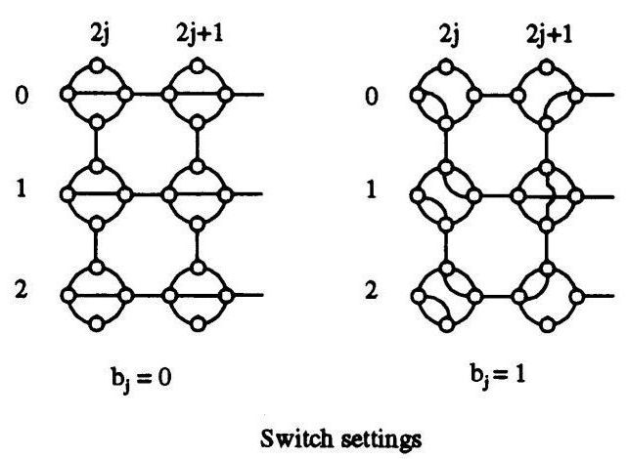
Example: Switch Configuration on XOR Algorithm
n = 3
Mesh size = 2n X 3

Slide 9
Some Reconfigurable Mesh Algorithms
Time` | Mesh Size | Problem
O(1) | 2n X 3 | XOR
O(1) | 1 X n | Prefix-And of n 1-bit numbers
O(1) | n X n | Maximum of n (log n)-bit numbers
O(1) | n X nk | Addition of n k-bit numbers
O(1) | n X n | Multiplication of two n-bit numbers
O(1) | n X n | Division of two n-bit numbers
O(1) | n X n | Sort of n O(log n)- bit numbers
O(1) | n X n | Convex Hull of n points
O(1) | n X n | Smallest enclosing rectangle of n points
O(1) | n² X n | Triangular enclosing of n planar points
O(1) | n X n | All-pairs nearest neighbors of n points
O(log n) | n X n | Connected components of an n X n image
Logic, arithmetic sorting and selection
Graph and image algorithms

Slide 10
Related Work
Currently, the following environments have been developed:
A Simulator for the Reconfigurable Mesh Architecture, 1998
Serial simulation of reconfigurable mesh, an image understanding architecture, 1998
Java Applet to Visualize Algorithms on Reconfigurable Mesh, 2000
ARMLang: A Language and Compiler for Programming Reconfigurable Mesh Many-Cores, 2009

Slide 11
Compiler Design
The Front-End of the compiler
Lexical Analyzer
Syntax Analyzer (Parser)
Semantic Analyzer
String of characters
Lexical
analyzer
String of tokens
Parser
Symbol table and
access routing
Abstract syntax tree
Semantic
analyzer
The Back-End of the compiler
Code Generator
Syntax tree
`
Code generator
Target code, multi threaded
Fig. 4: High level structure of a simple compiler

Slide 12
'Program' 'XOR'
'var'
'Mesh' 'm' '[' '3' ']' '[' '16' ']' ';'
'Register' 'r1' ';'
'Input' 'X' '[' '8' ']' ';'
'Output' 'Y' '[' '3' ']' ';'
'Step'
'R:'
'C:'
'B:' 'if' '(' 'Column' '%' '2' '==' '0' ')' 'then'
'if' '(' 'Row' '==' '2' ')' 'then'
'Connect' '(' 'SOUTH' '-' 'EAST' ')' ';'
'else'
'Connect' '(' 'NORTH' '-' 'SOUTH' '-' 'EAST' ')' ';'
'fi'
'fi'
'W:'
'Step'
'R:' 'Scan' '(' 'm' ',' '[' '0' ',' '0' ']' '[' '0' ',' '16' ']' '[' '0' ',' '2' ']' ',' 'X' ',' 'SOUTH' ')' ';'
'if' '(' 'Column' '%' '2' '==' '0' ')' 'then'
'm' '.' 'r1' '=' 'SOUTH' ';'
'else'
'm' '.' 'r1' '=' 'WEST' ';'
'fi'
'C:'
'B:' 'if' '(' 'm' '.' 'r1' '==' '0' ')' 'then'
'if' '(' 'Column' '%' '2' '==' '0' ')' 'then'
'if' '(' 'Row' '==' '0' ')' 'then'
'Connect' '(' 'WEST' '-' 'NORTH' ',' 'SOUTH' '-' 'EAST' ')' ';'
'fi'
'if' '(' 'Row' '==' '1' ')'
'Connect'

Slide 13
If (column%2 ==0 ) then m.r1 = 0
else m.r2 = 1
fi
If_stat
IF
expr
THEN
Stat_seq
ELSE
stat_seq
if_stm_end
if
then
else
fi
class ASSIGN atom ';'
expr EQU expr
class ASSIGN atom ';'
ide '.' ide
=
INTCONST
==
ide '.' ide
=
INTCONST
expr MOD expr
atom
m
r1
1
m
r1
0
%
INTCONST
IDE
2
0
column

Slide 14
Our Solution
Compiler for the Reconfigurable Mesh Language
Translate the RM Algorithms to runnable code
Lex
Yacc/Bison
Code generator
Working Environment to easy the writing of the RM Algorithms
Text editor
Running simulation
Debugger

Slide 15
Compile Process
Sequence diagram

Slide 16
Text Editor

Slide 17
Debugger

Slide 18
Implementation Obstacles
Will require to deal with obstacles in the separated modules
Compiler Design
Run Time Environment
Implement the interaction between the different interfaces
Editor
Compiler
RT-Env

Slide 19
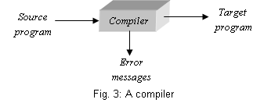
Compiler Design - Obstacles
Building a compiler for the RM Algorithms will require:
Defining a language to support easy design of high-level algorithms
Writing regular expressions
Writing context-free grammar
Generate target code to be executed
Create compiling errors messages

Slide 20
Run Time Environment - Obstacles
Building an environment for the RM Algorithms will require to deal with the following:
Assemble the bus effectively
Efficient bus management
Detecting short-circuit on the bus
Generic environment
Modeling different objects:
Process Element
Mesh
Connection
Target code
RT-Env
Simulation
Run Time errors

Slide 21
The Compilation Process
Source code
Characters stream
Lexical Analyzer
Regular expressions using “Flex”
Token stream
Syntax Analyzer
Context-free grammar using “Bison”
Abstract syntax tree
Semantic Analyzer
RM language semantic + target code generator using C program
Syntax tree
Code Generator
Target code, multi threaded

Slide 22
Run Time Environment Module

Slide 23
Lexical Analyzer
var Mesh m[8][8];
m.r1 = m.r2 + 1;
Lexical Analyzer
'var' 'Mesh' 'identifier' '[' 'integer' ']' '[' 'integer' ']' 'semicolon'
'identifier1' 'assignment statement' 'identifier2' '+' 'integer' 'semicolon'

Slide 24
Syntax Analyzer
'var' 'Mesh' 'identifier' '[' 'integer' ']' '[' 'integer' ']' 'semicolon'
'identifier1' 'assignment statement' 'identifier2' '+' 'integer' 'semicolon'
Syntax Analyzer
Program
variableDeclaration
functionDeclaration
body
var
meshDefinition
registerDefinition
IOvectorDefinition
ε
assignment statement
Mesh
meshIdentifier
meshDimension3
ε
ε
Identifier₁
=
expression
semicolon
m
[
integer
]
meshDimension2
m.r1
Identifier₂
+
integer
8
[
integer
]
meshDimension1
m.r2
1
8
semicolon

Slide 25
Semantic Analyzer
Program
variableDeclaration
functionDeclaration
body
var
meshDefinition
registerDefinition
IOvectorDefinition
ε
assignment statement
Mesh
meshIdentifier
meshDimension3
ε
ε
Identifier₁
=
expression
semicolon
[
integer
m
]
meshDimension2
m.r1
Identifier₂
+
integer
8
[
integer
]
meshDimension1
m.r2
1
8
semicolon
Semantic Analyzer
Continue to code generation

Slide 26
Code Generation
Program
variableDeclaration
functionDeclaration
body
var
meshDefinition
registerDefinition
IOvectorDefinition
ε
assignment statement
Mesh
meshIdentifier
meshDimension3
ε
ε
Identifier₁
=
expression
semicolon
[
integer
m
]
meshDimension2
m.r1
Identifier₂
+
integer
8
[
integer
]
meshDimension1
m.r2
intToBit
8
semicolon
1
Code Generator
Multi threaded code in C#
Mesh file:
Mesh m = new Mesh(8,8);
Processing element file:
r1 = r2 + 1;

Slide 27
The Compilation Process - Example
var:
Logic AND
Var
Mesh m[1][8];
Register r1;
Input x[N];
Output y[1];
Begin R: scan(m,[0,0][0,7][0,1],x,SOUTH);
m.r1=SOUTH;
B: if (m.r1==1) then connect (WEST-EAST); endif
W: Execute(m,[0,0][][],'1',WEST);
if (m.r1 == '0') then m.EAST='0'; endif print(m,[0,N-1][][],y,WEST);
End
R:
X =
1 0 1 0 1 1 0 0
B:
W:
‘1’
‘0’
‘0’
‘0’
‘0’
print:
‘0’

Slide 28
Obstacles
Effective partition and threads management

Slide 29
Benefits and Future Plans
This working environment can be used for testing new algorithms developed for Reconfigurable Mesh
Valuable tool for studying and understanding the behavior of parallel algorithms on the Reconfigurable Mesh
Translating into FPGA components
Expanding the language

Slide 30
References
[1]. H. Giefers and M. Platzner "Realizing Reconfigurable Mesh Algorithms on Softcore Arrays" appears in: "Embedded Computer Systems: Architectures, Modeling, and Simulation, 2008. SAMOS 2008. International Conference on", pp 41-48, July 2008.
[2]. Reisis, D.I. "An efficient convex hull computation on the reconfigurable mesh", Parallel Processing Symposium, 1992. Proceedings, Sixth International, pp 142-145.
[3]. K. Miyashita and R. Hashimoto, "A Java Applet to Visualize Algorithms on Reconfigurable Mesh", in Proc. of the 15th Workshops on Parallel and Distributed Processing, IPDPS ’00, 2000, pp. 137–142.
[4]. K.C. Louden, "Compiler construction, principles and practice", PWS Publishing Company, pp 1-2, 31-138,1997.
[5]. Y. Ben-Asher and E. Stein, "Basic Algorithms for the Asynchronous Reconfigurable Mesh", VLSI Design Volume 15 (2002), Issue 1, Pages 441-454.
[6]. R. Wilhelm & D. Maurer, "Compiler Design", Wokingham, UK: Addison Wesley, pp 222 – 233, 1995.
[7]. S. Muchnick, "Advanced compiler design and implementation", San Francisco, CA : Morgan Kaufmann, pp 1-3, 1997.
[8]. C. Steckel, M. Middendorf, H. ElGindy and H. Schmeck, "A Simulator for the Reconfigurable Mesh Architecture", "Parallel & Distributed Processing", pp 99-104, 1998.
[9]. M. Murshed and R. Brent, “Serial simulation of reconfigurable mesh, an image understanding architecture”, Advances in Computer Cybernetics, vol. 5, pp. 92–97, 1998.
[10]. H. Giefers and M. Platzner, "ARMLang: A Language and Compiler for Programming Reconfigurable Mesh Many-Cores", Parallel and Distributed Processing Symposium, International pp. 1-8, 2009 IEEE International Symposium on Parallel&Distributed Processing, 2009.

Slide 31
ANNEXE I - Example of Algorithm in RM Language
Left Most Determine
Var
Mesh m[1][N];
Register r1, r2;
Input x[N];
Output y[1];
Begin R: scan(m, [0,0][0,N-1][0,1], x, SOUTH);
m.r1=South;
B: if (m.r1==0) then
connect (WEST-EAST);
endif
W: execute(m, [0,0][][],'0',WEST);
if (m.r1 == '1') then m.EAST = '1'; endif
R: if (m.r1 == 1) then
m.r2=WEST;
if (m.r2 == 0)
NORTH = '1';
else NORTH = '0'
endif
endif
print(m, [0,0][0,N-1][0,1], y, NORTH);
pst(y);
End

Slide 32
ANNEXE II Language Definition
Var
Mesh <name>[D1][D2][D3]; register<name>,<name>,…,<name>; Input <name>[D1]; Output <name>[D1];
Program
scan(<to>,[<start_D1>,<start_D2,<start_D3>][<end_D1>,<end_D2,<end_D3>][<jump_D1>,<jump_D2>,<jump_D3>], <from>,<Direction>);
print(<from>,[<start_D1>,<start_D2,<start_D3>][<end_D1>,<end_D2,<end_D3>][<jump_D1>,<jump_D2>,<jump_D3>], <to>,<Direction>);
execute(<to>,[<start_D1>,<start_D2,<start_D3>][<end_D1>,<end_D2,<end_D3>][<jump_D1>,<jump_D2>,<jump_D3>], <from>,<Direction>);
assign value to register: <mesh_name>.<regname>=<direction>; // note: The value will be assign to the all Mesh.
<mesh_name>[D1][D2][D3].<regname>=<direction>; // note : the value will be assigned to the dimension according to the number of dimensions
assign value to Direction:
<mesh_name>.<Direction> = <register_name>| <value>; <mesh_name>[D1][D2][D3].<direction>=<register_name>| <value>;
Special Assist Function;
1UN(< Output_vector >) – sum the '1' in the Output Vector.
2UN(< Output_vector >) – sum the joined (to the left) '1' in the Output Vector.
BIN(< Output_vector >) – Decimal representation of the Output Vector.
PST(< Output_vector >) – Returns the location of the singular '1' in the Output vector.

Slide 33
ANNEXE III The RM language BNF / production rules for the syntax analyzer
Program ⇒ variableDeclaration functionDeclaration Body variableDeclaration ⇒ "Var" meshDefinition registerDefinition IOvectorDefinition meshDefinition ⇒ "Mesh" meshIdentifier meshDimension3 meshDimension3 ⇒ "[" Integer "]" meshDimension2 meshDimension2 ⇒ "[" Integer "]" meshDimension1 | meshDimension1 meshDimension ⇒ "[" Integer "]" semicolon | semicolon registerDeclaration ⇒ "Register" identifiers identifiers ⇒ registerIdentifier nextIdentifier nextIdentifier ⇒ "," registerIdentifier nextIdentifier | semicolon
meshIdentifier ⇒ id
registerIdentifier ⇒ id
value ⇒ Number | registerIdentifier

Slide 34
ANNEXE III The RM language BNF / production rules for the syntax analyzer
Body ⇒ "Program Begin" Step Functions "End" Step ⇒ newline readPhase Block newline calculatePhase Block newline busPhase Block newline writePhase Block | newline readPhase Block newline calculatePhase Block newline busPhase Block newline writePhase Block Step readPhase ⇒ "R" ":" calculatePhase ⇒ "C" ":" busPhase ⇒ "B" ":" writePhase ⇒ "W" ":" connectionConfiguration ⇒ "Connect" "(" switchConfiguration nextConfiguration ")" nextConfiguration ⇒ "," nextConfiguration | switchConfiguration | semicolon switchConfiguration ⇒ "VOID" | "NORTH-SOUTH" | "WEST-EAST" | "NORTH-WEST" | "NORTH-EAST" | "SOUTH-EAST" | "SOUTH-WEST" | "NORTH-WEST-SOUTH" | "NORTH-WEST-EAST" | "NORTH-EAST-SOUTH" | "EAST-SOUTH-WEST"| "NORTH-SOUTH-WEST-EAST" | "N0RTH" | "SOUTH" | "WEST" | "EAST"

Slide 35
ANNEXE III The RM language BNF / production rules for the syntax analyzer
basicDirection ⇒ | "N0RTH" | "SOUTH" | "WEST" | "EAST"
Block ⇒ statement | statement nextStatament
nextStatement ⇒
statament ⇒ scanStatement | printStatement |executeStatement | assignRegisterStatement | assingDirectionStatement | connectionConfiguration
scanStatement ⇒"scan" "(" id "," algorithmCoordinates "," id "," switchConfiguration ")" semicolon
printStatement ⇒"print" "(" id "," algorithmCoordinates "," id "," switchConfiguration ")" semicolon
executeStatement ⇒"execute" "(" id "," algorithmCoordinates "," id "," switchConfiguration ")" semicolon
assingRegisterStatement ⇒ meshIndentefier Dimention "."registerndetefire "=" basicDirection semicolon
assingDirectionStatement ⇒ meshIndentefier Dimention "." switchConfiguration "=" value semicolon
algorithmCoordinates⇒ startCoordinates endCoordinates jumpCoordinates semicolon
StartCoordinates ⇒ Dim "," Dim | Dim "," Dim "," Dim endCoordinates ⇒ Dim "," Dim | Dim "," Dim "," Dim jumpCoordinates ⇒ Dim "," Dim | Dim "," Dim "," Dim Dim ⇒ "["Integer "]"

Slide 36
Use Case

Slide 37
Basic Data Structure

